Slide 1
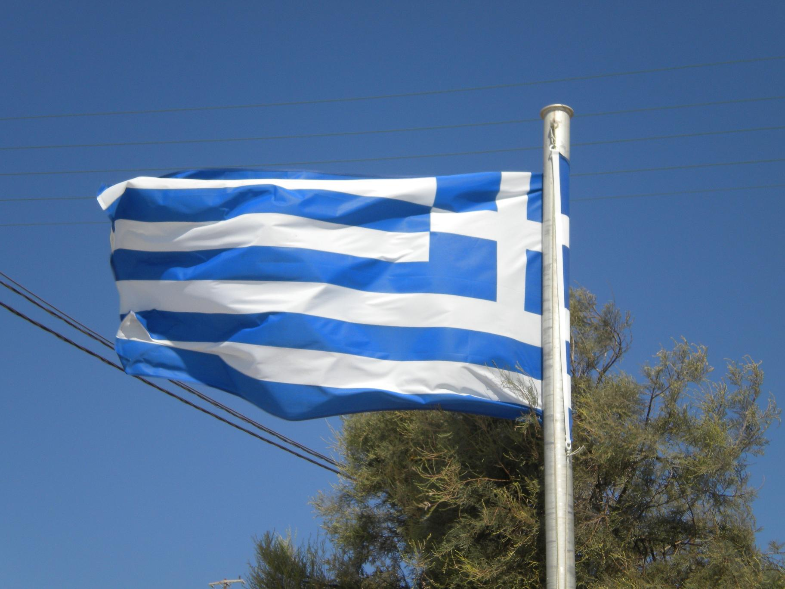
About e-Book shared building
Ermioni 13 Aplil 2014
Renato Luti – EdaForum, Italy
Working paper for Congenial e-book

Slide 2

Question points
Ermioni 13 April 2014

Slide 3
I. Draft general indications
(by EdaFirum, Glenda Galeotti) (shared by gmail group)
who write what (you can contribute sending your work to Glenda)
however the last word/work competes to EdaForum (Glenda, Gilda, and staff of EdaForum-Fi)
Ermioni 13 April 2014

Slide 4
II. About the contens
    see examples on blog http://congenialebook.wordpress.com/2013/11/23/starting-working-collaboratively/
    23 days to contribute, till 2014 May 9th, sending all to Glenda glendagaleotti@yahoo.it
    rely
Ermioni 13 April 2014

Slide 5
III. Question on the format/extension (it is regarding maximum reading on maximum of device)
1. the most common: .pdf (static presentation, but surely executable on pc, mac, android, kindler and much more), .ibook (for mac and few more), .Mobi Mobipocket eBook Format (Amazon.com Inc.), .ePub (from International Digital Publishing Forum, EPUB it’s a open format based on XHTML e XML), to see other in list vist http://www.ebook-reader.it/news/guida-ai-formati-per-ebook-reader/
Ermioni 13 April 2014

Slide 6
III. Question on the format/extension (it is regarding maximum reading on maximum of device)
2. first edition in .pdf, you must agree blind - ☺
Ermioni 13 April 2014

Slide 7
III. Question on the format/extension (it is regarding maximum reading on maximum of device)
3. several extensions in same file using a dedicated program
(by exemple “Calibre”)
Ermioni 13 April 2014

Slide 8
III. Question on the format/extension (it is regarding maximum reading on maximum of device)
4. last decision by EdaForum staff per competence.
Ermioni 13 April 2014

Slide 9
IV. Question about attached files (documents, pictures, photoes, videos) where to store the files?
[at the end of e-book there is a page to insert attachments and references]
    1. embedded: only few extentions can accept that solution ☹
Ermioni 13 April 2014

Slide 10
IV. Question about attached files (documents, pictures, photoes, videos) where to store the files?
    2. conserved in own server of each partner institution [recomended 1st ☺]
Ermioni 13 April 2014

Slide 11
IV. Question about attached files (documents, pictures, photoes, videos) where to store the files?
    3. external servers (youtube for videos and webalbum for photo-album) [recomended 2nd ] this solution riquired upload by every partner too.
Ermioni 13 April 2014

Slide 12
essential
That last question, about attached files, videos and photo albums is crucial and critical, because from the solution depend the richness of media and archives reached from our ebook; and more, its slimness and fluency in reading; and finally , this consideration influences the adoption of the final standard of publishing/reading.

Slide 13
remote help and assistance by EdaForum (Renato) is guaranteed: renalut@live.it 0039 3292170677 http://congenialebook.wordpress.com/2013/11/23/starting-working-collaboratively/ clicking on Leave a Reply and writing …
Ermioni 13 April 2014

Slide 14

way is wide open
Ermioni 13 April 2014
Renato Luti - magicore

